Slide 1
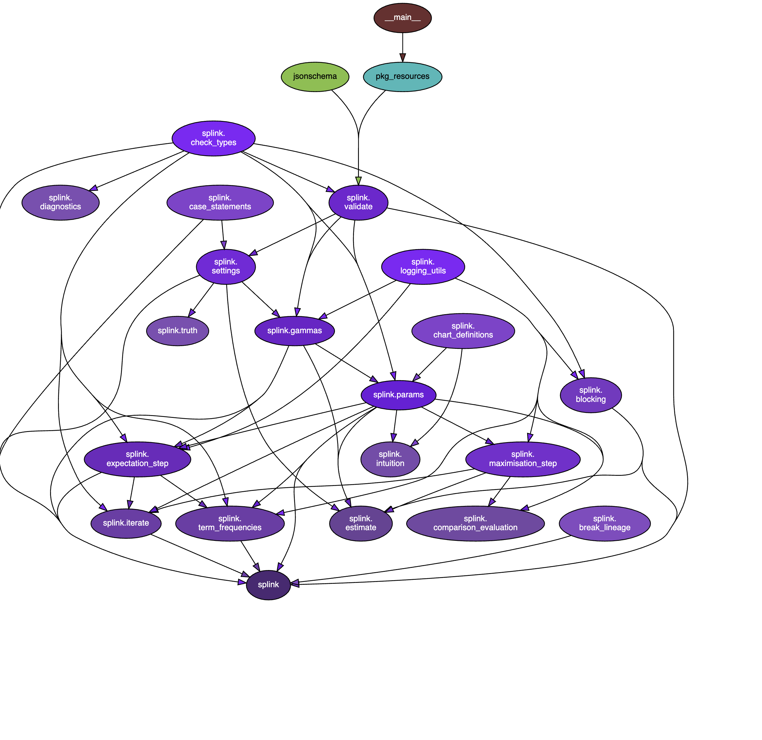
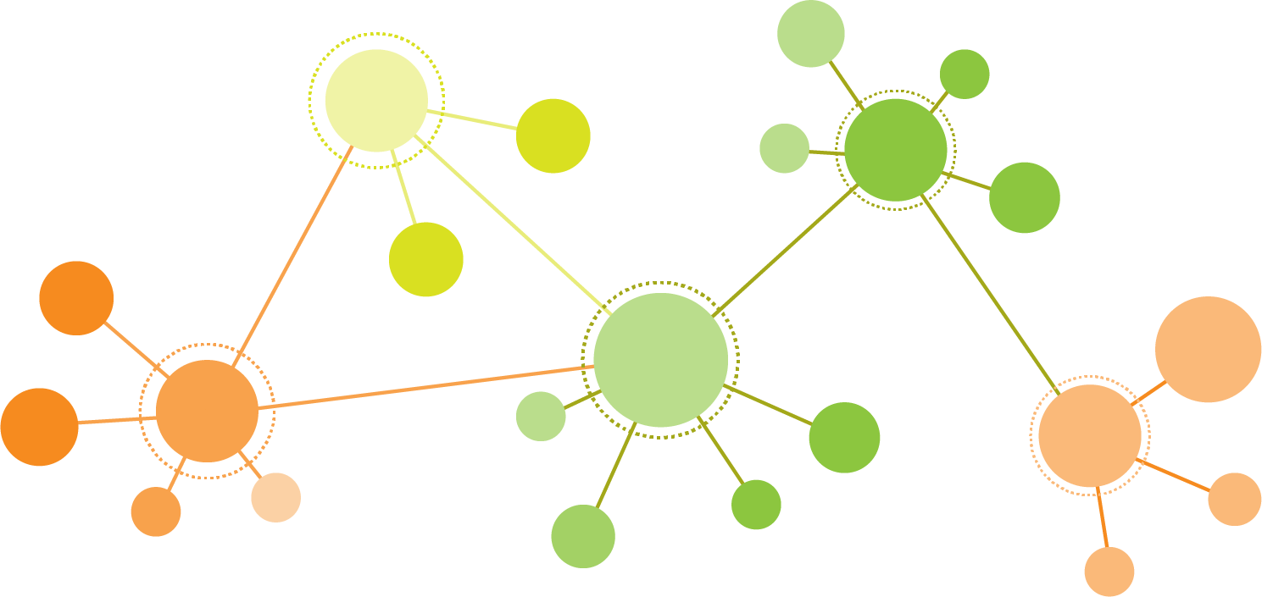
Graphs / Networks are everywhere

Slide 2

Where do I start
Need: a gentle introduction
Online tutorial
Interactive
No programming necessary
https://d3gt.com/index.html

Slide 3
Where do I start
Need: a gentle introduction
Chapter 1&2 from Network Science book
http://networksciencebook.com/

Slide 4
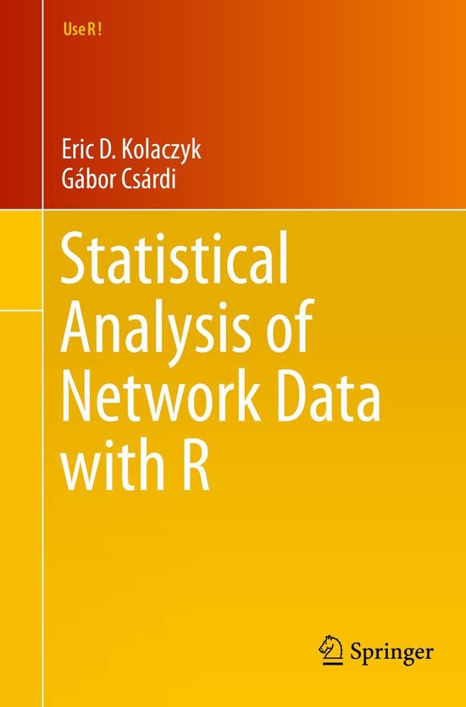
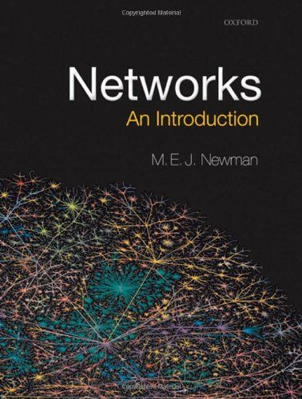
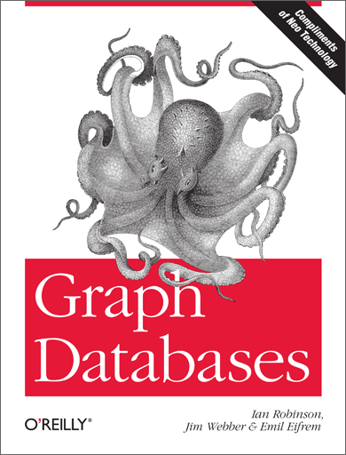
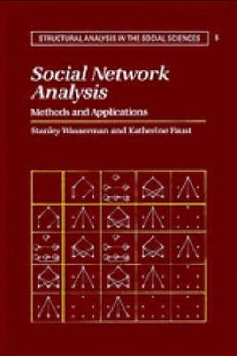
Intermediate level
Need: Where I can find more?

Slide 5
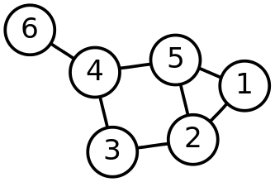
Definitions
• Node - Individual Element
• Edge - Connection between elements
• Degree - Number of edges connected to a node
• Weighted Graphs - Edges with a weight associated
In weighted graphs edges have a weight that could represent :
cost of traversing
a similarity score
a distance score
In unweighted graphs edges have no weight and simply show connections
• Directed Graphs - “One way street”
• Subgraph : A set of vertices and edges that are a subset of the full graph's vertices and edges.

Slide 6
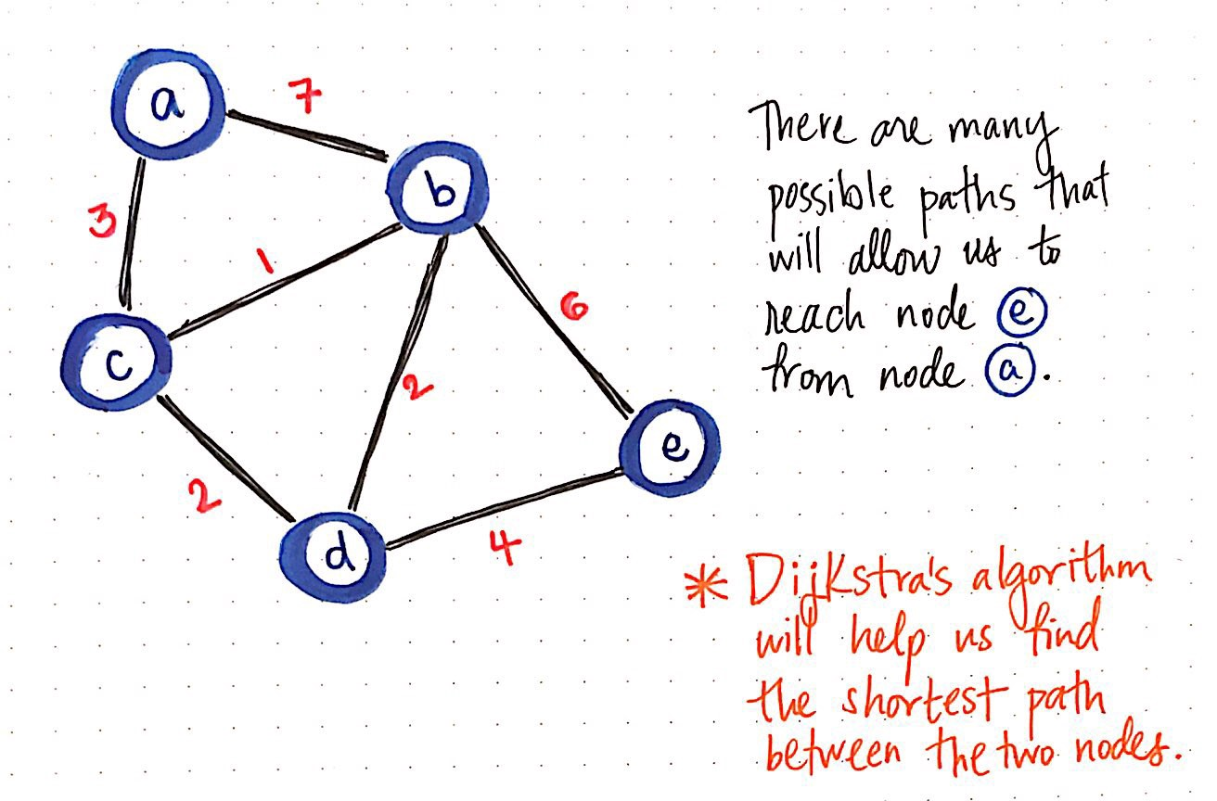
Definitions II
• Connected Graph - every node can reach the other node in the graph
• Disconnected Graph
• Connected component : A strongly connected subgraph, meaning that every node can reach the other nodes in the subgraph
Shortest path:
unweighted: The lowest number of edges required to
traverse between two specific vertices/nodes.
weighted: shortest path based on traversal cost

Slide 7
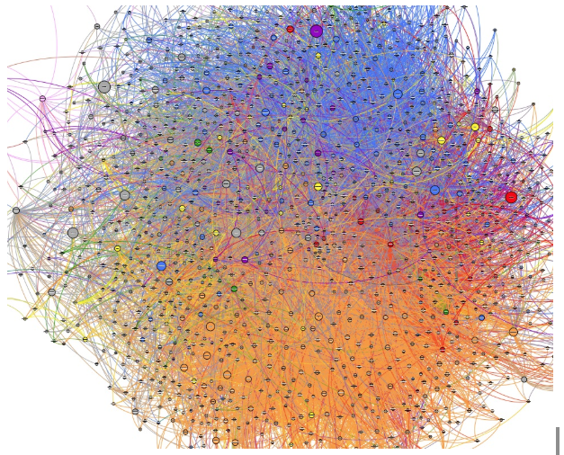
Graph Metrics: why need them?
When NOT to use graph visualizations:
No additional knowledge can be gained from nodes positioned into a graph layout – no interesting pattern can be identified.

Slide 8
Node Degree
The most fundamental property of a node is its degree (k), the number of connections of a node
In the case of directed networks, we distinguish between in-degree, (number of incoming connections) and out-degree (number of outgoing connections).
Another useful property is the Degree distribution P(k)
The relative frequency of each degree value

Slide 9
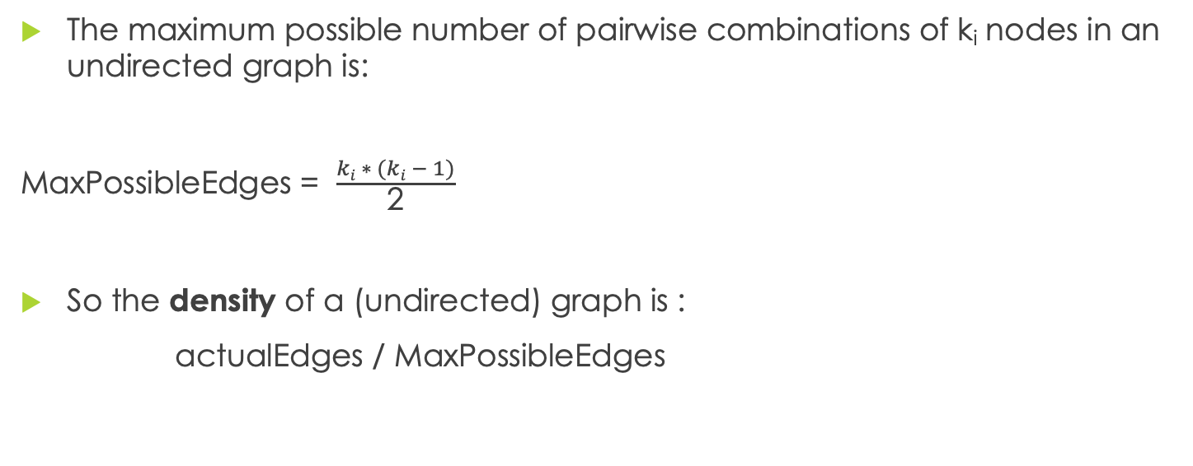
Density
The maximum possible number of pairwise combinations of k_{i} nodes in an undirected graph is:
MaxPossibleEdges = $\frac{ki ∗ (ki − 1)}{\text{2}}$
So the density of a (undirected) graph is :
actualEdges / MaxPossibleEdges

Slide 10


Graph representations: Adjacency Matrix
A matrix with non-zero elements only in the edges that are present (1, for unweighted networks, !=1 for weighted networks) Undirected networks result in symmetric matrices, while directed networks result in asymmetric ones

Slide 11
Graph representations: Edge List and Node list
Node List: List of nodes
Edge List: Just the list of edges (the nodes that comprise the edge)
Common way to write graphs to file.
Weights can be added as a third element in each edge.

Slide 12
Centrality
Centrality is all about understanding which nodes are more important in a network.
But what do we mean by importance?
There are different types of centrality algorithms created to measure different things
such as the ability to quickly spread information
or ability to bridge distinct groups.

Slide 13
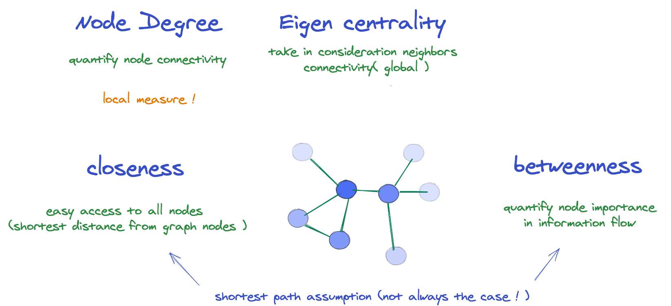
Centrality: measure importance of node

Slide 14
Clustering Coefficient

Slide 15
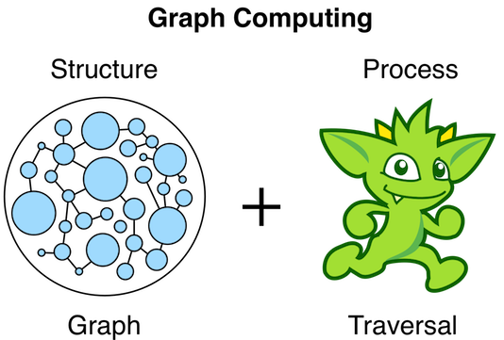

Slide 16
Graph/Network Analysis in R
Install.packages(“igraph”)
Install.packages(“ggraph”)
Install.packages(“snahelper”)
Install.packages(“ggforce”)
install.packages("graphlayouts")
https://github.com/moj-analytical-services/graph-club/tree/Tutorial_Branch/00_StartHere

